Slide 1
LevUL up UL’s Student Digital Skills Series Using EndNote Online For Your References

Slide 2
Overview EndNote is a type of reference management software that will help:
• Gather references automatically from databases
• Format documents & citations instantly in a variety of styles
• Generate bibliographies
• Create & organise a personal research database of references & PDFs
• Share citations with colleagues.

Slide 3
Objectives
At the end of this tutorial, you will know how to:
• Register for an EndNote Online account
• Add references to your account
• Organise references in your account
• Create bibliographies in Word
• Edit citations
• Choose bibliographic styles

Slide 4
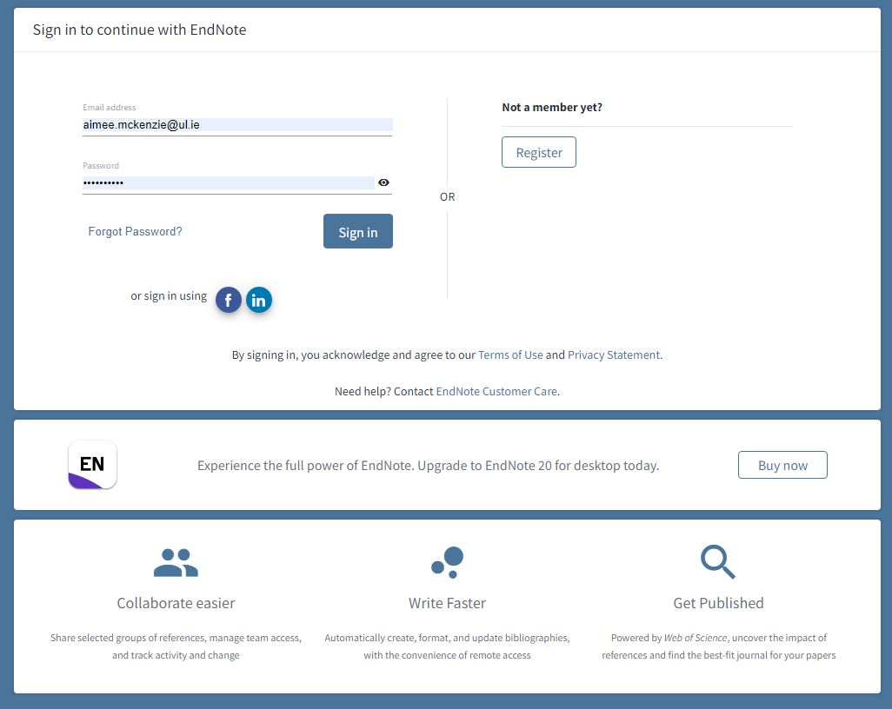
Register for EndNote Online Account
Register on campus using a networked PC rather than wireless at www.myendnoteweb.com

Slide 5
Registering Off Campus for Endnote Online
• Full details to register for EndNote Online are on this link if you
have not done so already.
https://libguides.ul.ie/referencing-endnote/endnote-online

Slide 6
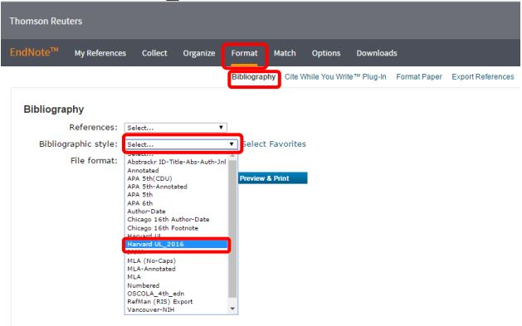
Checking for the UL version of EndNote Online
To check that you have been registered correctly for the UL subscription to EndNote Online, go to Format > Bibliography.
Then click on the drop-down list beside Bibliographic Style and ensure that Harvard UL_2016 is listed.

Slide 7
Adding References

Slide 8
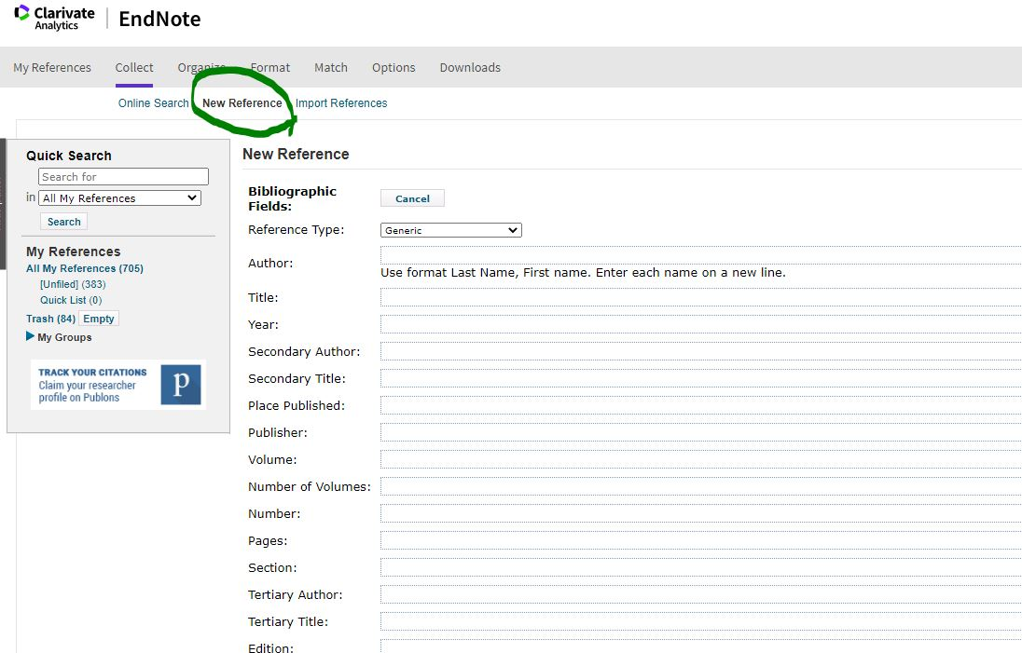
Manually
New Reference
Reference Type (book, journal, etc.)
Fill in the necessary details as described
in the Cite It Write guide
Save
Click for link

Slide 9
Importing References
Open the UL Library website at www.ul.ie/library
Go to Explore Collections Go to Scopus.
Type “renewable energy” into the first search box, then click Search
Select the references by clicking the box to the left of each reference
Scroll to the top of your search results and click on the three dots on the right-hand side
Click on EndNote Web in the dropdown.

Slide 10
Importing References
Remember to import the EndNote Web format on all sites
Some sites will let you import more than one reference at a time
If the reference doesn’t automatically import, save the reference as a RIS format
Go to your EndNote online > Collect > Import References
File: Choose file > choose your downloads folder
Import Options: Select RefMan RIS
To: Select the folder where you want the reference, or create a new group or leave it in the unfiled folder

Slide 11
Creating folders to organise your EndNote library
Create a folder
Select Organise from the menu
Select Manage my groups
Click on New Group
Name the group and click OK
It will now be visible in the My References tab

Slide 12
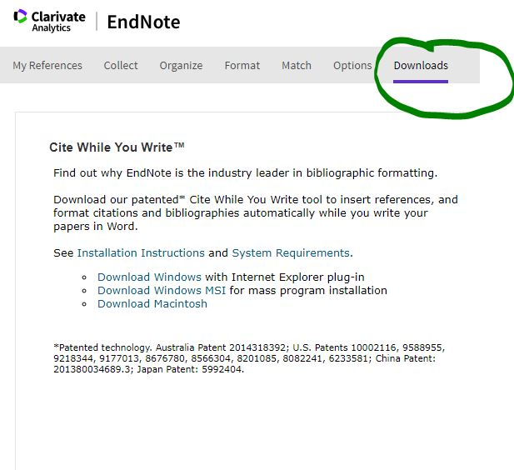
To download the Cite While You Write (CWYW) plug-in for Microsoft Word go to the Downloads tab in EndNote Online.

Slide 13
EndNote and Word
To add a reference in Word, click on the EndNote tab in the ribbon at the to of your document
Click on Insert Citation, type in the author’s name or subject in the Find field
Click on the reference you want to cite and hit Insert
Your reference list will begin below your typed text

Slide 14
EndNote and Word
The grey highlighting signifies a link between the document & your EndNote library.
If you make changes in the grey highlighted section in your Word document, the changes will revert.
To change anything from EndNote, go back to your EndNote library and edit it there.

Slide 15
Support & Resources
libinfo@ul.ie
EndNote Online
https://libguides.ul.ie/referencing-endnote/endnote-online
Contact Us
https://www.ul.ie/library/about/contact-us
Faculty Librarians
https://www.ul.ie/library/supporting-you/consult-librarian

Slide 16
Additional Support
EndNote Online: Help Documentation
https://www.myendnoteweb.com/help/en_us/ENW/help.htm
UL’s Video Tutorial on how to use EndNote Online
https://youtu.be/DtnwblU5PpQ

Slide 17
ul.ie
Contact Library
Email: libinfo@ul.ie
Web/Chat: ul.ie/library
Ask Us: ul-ie.libanswers.com
Social media
ullibrary
ullibrary
LibraryUL

